Slide 1

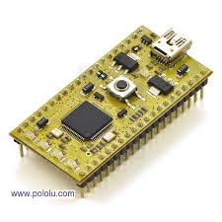
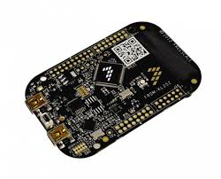
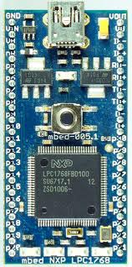

DEPARTMENT OF
ELECTRONICS & COMMUNICATION
SUPPORTED
ARM
BY
ARM University Program (AUP)
BMSCE
ARM
The ARM Cortex™-M0 processor is the smallest ARM processor available. The exceptionally small silicon area, low power and minimal code footprint of the processor enables developers to achieve 32-bit performance at an 8-bit price point.
- 60 ARM CORTEX-M0 LPC11U24 CONTROLLERS [NXP]
ARM CORTEX M0
The Cortex-M0+ is optimized superset of the Cortex-M0. The ARM Cortex™-M0+ processor is the most energy efficient ARM processor available. It builds on the very successful Cortex-M0 processor, retaining full instruction set and tool compatibility, while further reducing energy consumption and increasing performance.
- 10 ARM CORTEX-M0+ (FREESCALE) CONTROLLERS
ARM FREEDOM MO+
The ARM Cortex™-M3 processor is the industry-leading 32-bit processor for highly deterministic real-time applications, low-cost platforms for a broad range of devices including automotive body systems, industrial control systems and wireless networking and sensors. The processor delivers outstanding computational performance and exceptional system.
ARM CORTEX-M3
- 10 ARM CORTEX-M3 LPC1768 PROCESSORS [NXP]
Keil provides a broad range of development tools including online compilers for ARM. Keil MDK Version 5 is the latest release of complete software development environment for an ARM Cortex-M compiler.
The License Management allows licensing Keil software products.
- 100 Keil Licenses
KEIL

